Slide 1
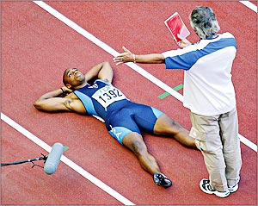
Special Olympic Seminar: The False Start Rule in Track & Field
Michael Rotkowitz
ECE & ISR
The University of Maryland

Slide 2
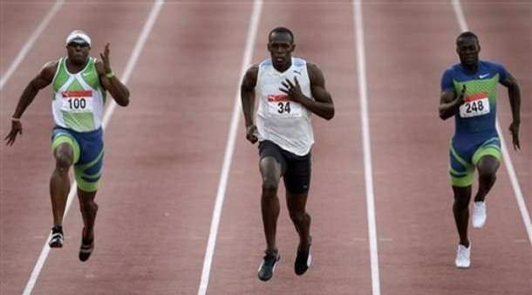
Acknowledgement – Julien Dunkley

Slide 3

2009 World Championships

Slide 4
Start
Three commands
Take your mark
Set
[gun fires]

Slide 5
Importance of Start
Reactions can vary by over 0.10 and races are often decided by 0.01.
About 2-3% of variance due to reaction.
Speakers in or behind starting blocks to prevent unfair advantage to inner lanes.
Lewis / Burrell anecdote 1991.

Slide 6
False Start Rules
False starts allowed
0 (as of 2010)
1 per field (2003 – 2010)
1 per runner (until 2003)
Threshold of 0.100 seconds after gun
Surprising lack of consistency and transparency in definition / measurement of reaction time
often 25 kg of force on either block

Slide 7
High-Profile DQs
Linford Christie (UK) – 1996 Olympic finals
Reaction time of 0.086
defending Olympic gold medalist
Jon Drummond (USA) and Asafa Powell (Jam) – 2003 World Championships quarterfinals
Reaction times of 0.052 and 0.086

Slide 8
Reasons for Skepticism
Would or more really be unattainable
Most false starts seem to be just shy of the threshold
Wouldn’t actual false starts be more evenly distributed?
Likelihood of a false start falling in 80-100 ms window seems very small
Perhaps smaller than that of a very fast fair start
Apparent lack of movement

Slide 9
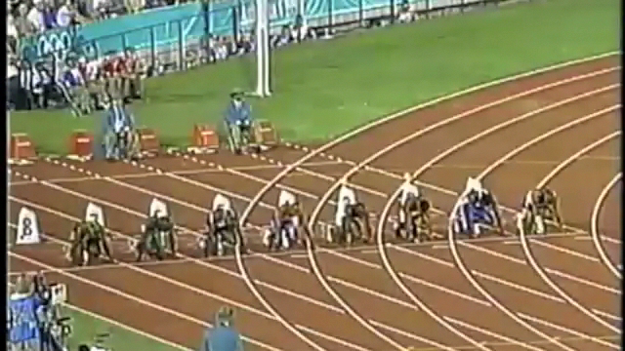
1996 Olympic Finals

Slide 10
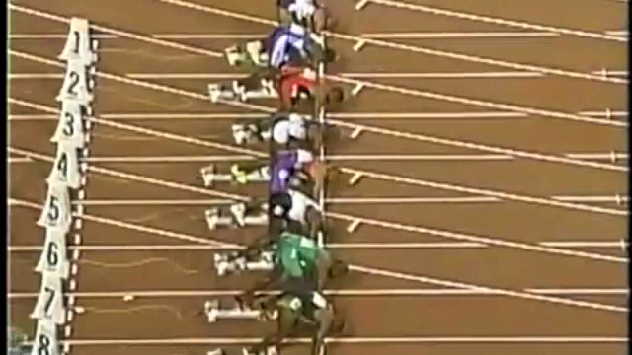
1996 Olympic Finals - slowmo

Slide 11
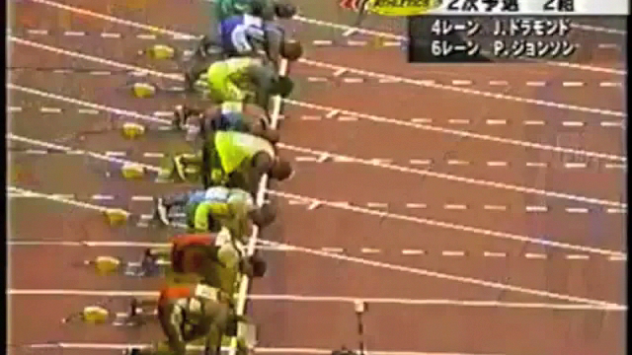
2003 WC – first FS

Slide 12
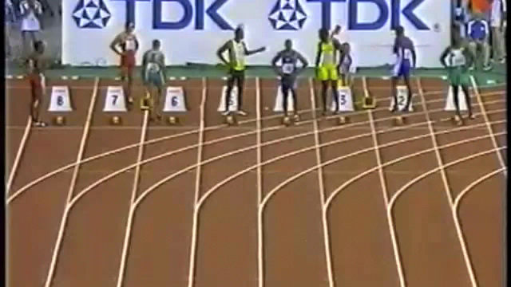
2003 WC – second FS

Slide 13
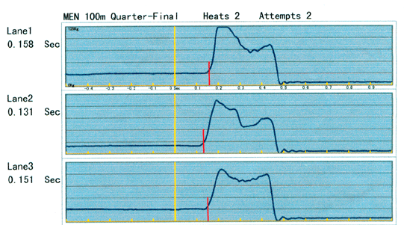
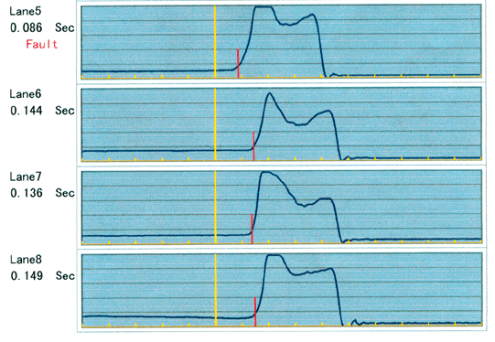
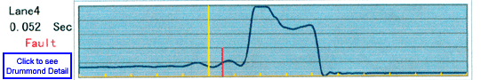
2003 WC Force Plate Readings

Slide 14
Data Used
Olympics and World Championships
Men
1997 – 2011
Finals
Earlier rounds, except for top 2 finishers
No data with RT < 0.100 available

Slide 15
Main Problems
Alternate hypothesis never considered
Relative costs of different errors never considered

Slide 16
3 recent studies
Pain and Hibbs (UK, 2006)
Brown et al (Canada, 2008)
Komi, Ishikawa, Salmi (Finland, 2009)
25 kg detection
133 (21) ms
3 of 7 subjects beat 100 ms at least once
fastest 78 ms!
best average 109 ms

Slide 17
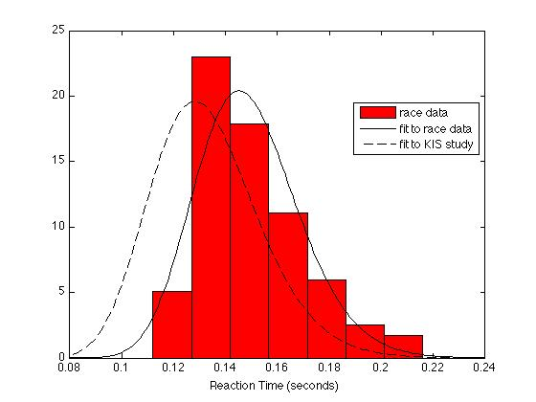
Fair start model

Slide 18
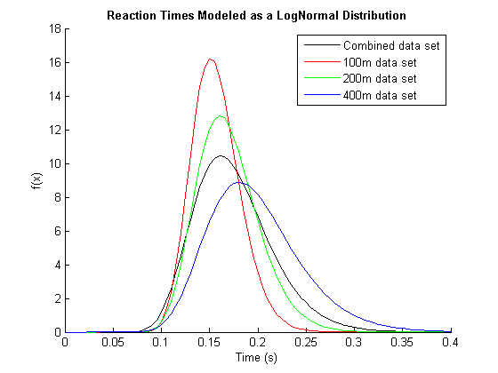
RT vs Race Distance

Slide 19
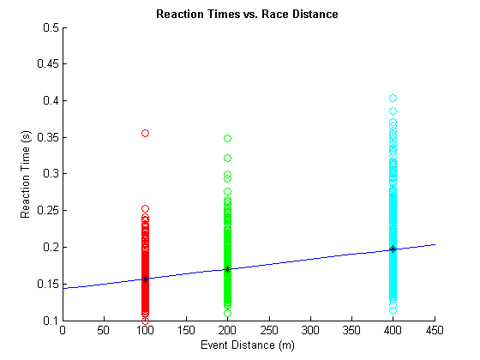
RT vs Race Distance (0.013)

Slide 20
Bizarre Defense
Lipps, Galecki, Ashton-Miller. “On the implications of a sex difference in the reaction times of sprinters at the Beijing Olympics”
Found confidence intervals based on combined 100, 200, 400 meter data!

Slide 21
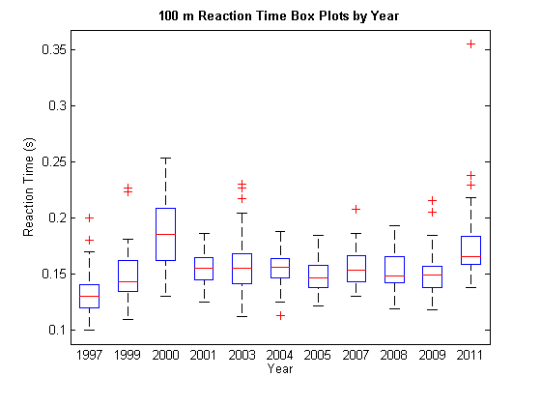
100 m RT by Year

Slide 22
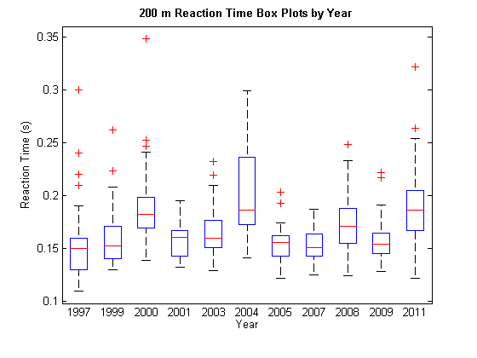
200 m RT by Year

Slide 23
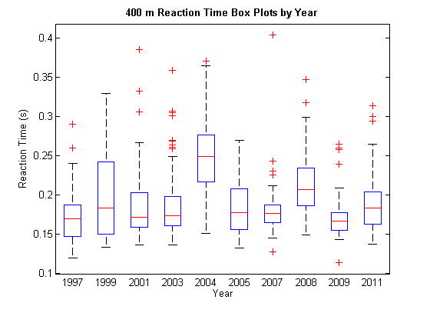
400m RT by year

Slide 24
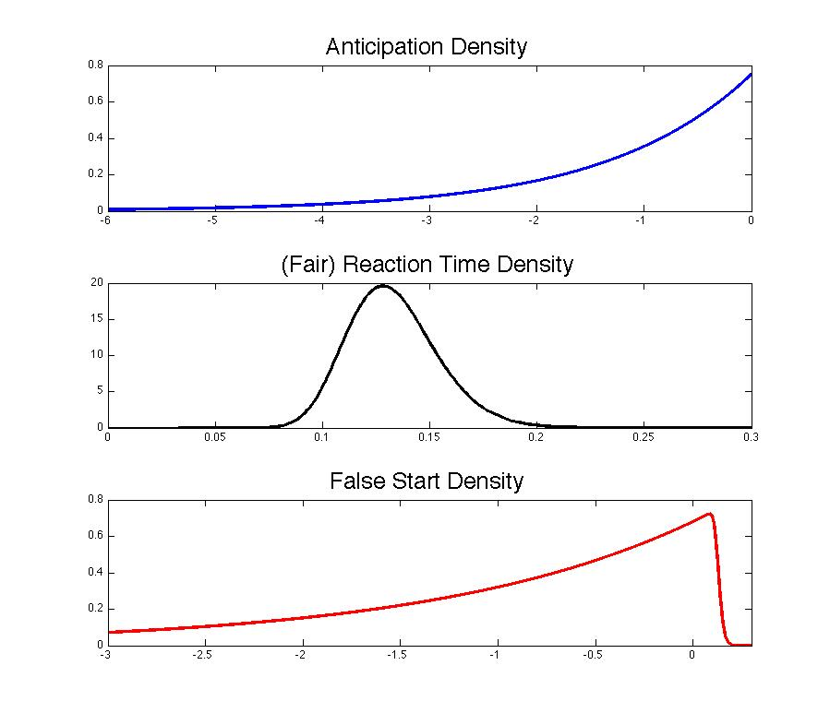

Slide 25
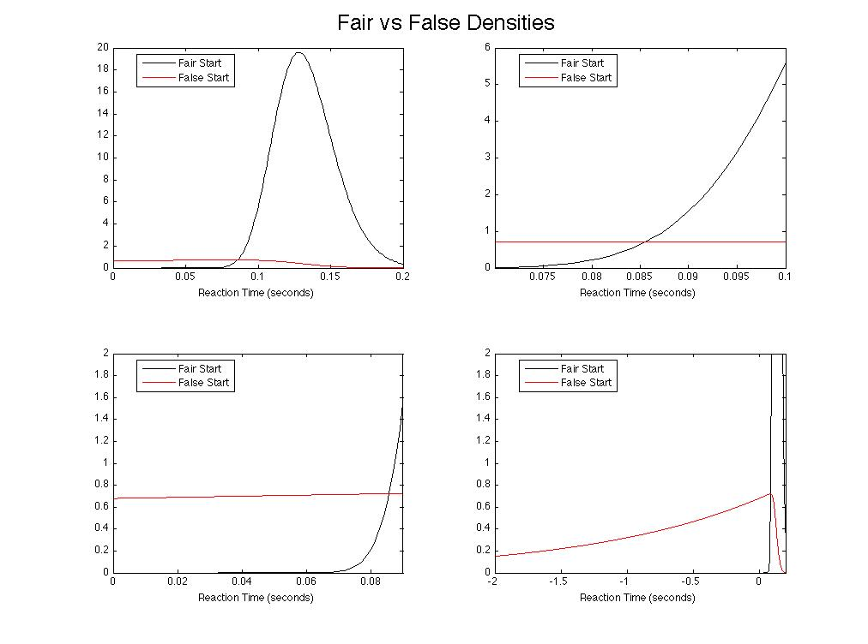

Slide 26
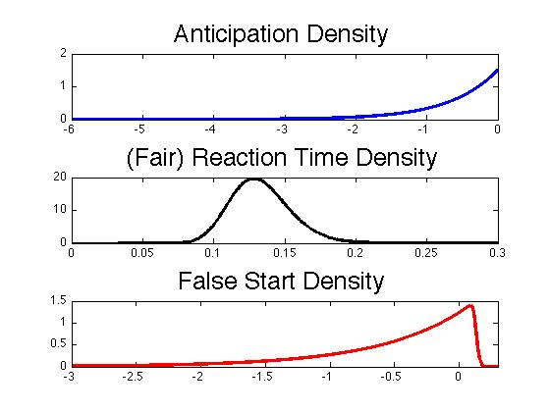

Slide 27
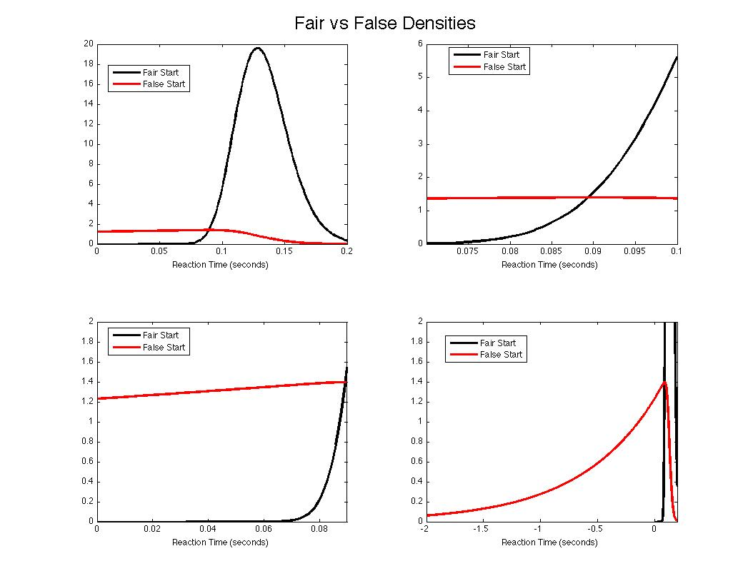

Slide 28
Degrees of Bayesianism
Frequentist |  | Fully Bayesian
Model fair reaction time, back out CI for initiation time | Model anticipation time as well | Further incorporate prior probability of jumping

Slide 29
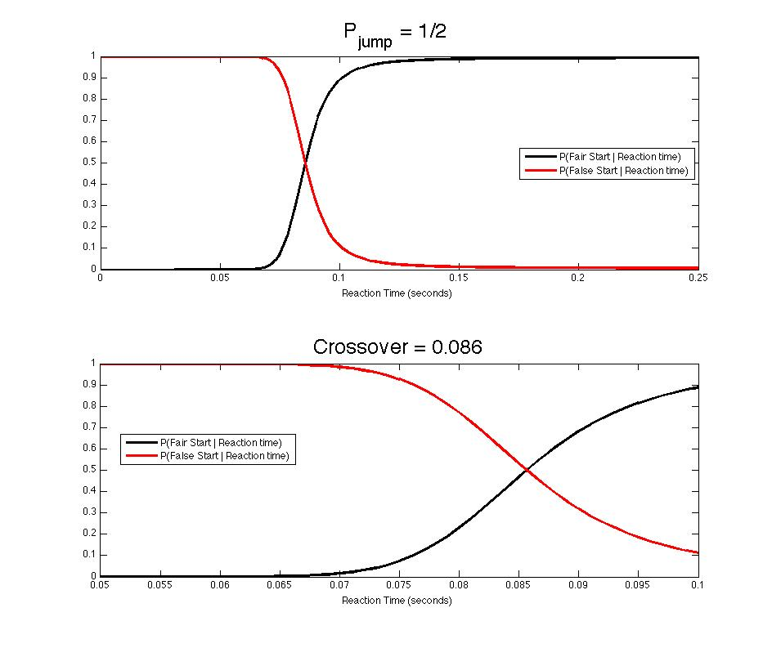
Bayesian approach

Slide 30
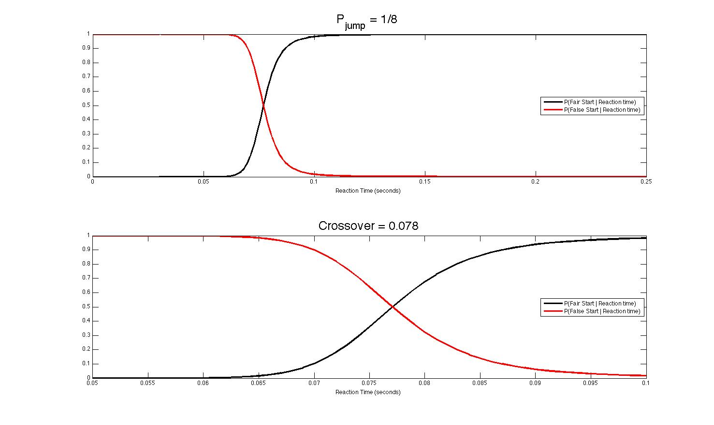
Bayesian approach

Slide 31
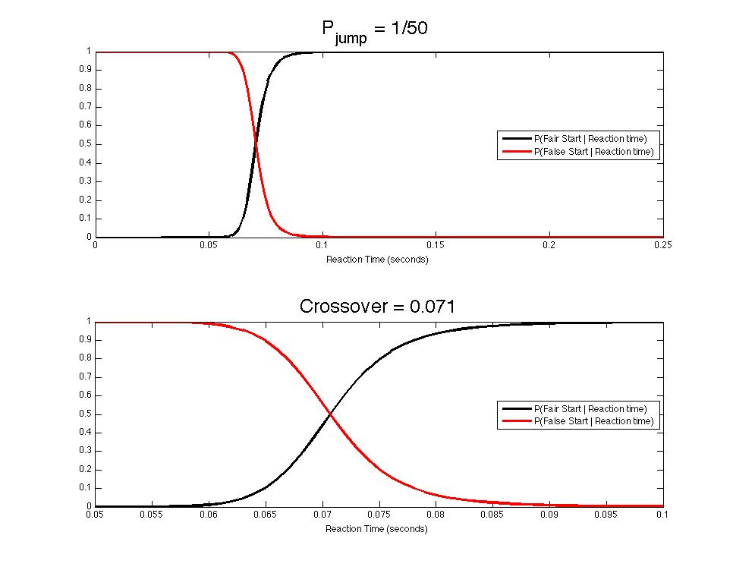
Bayesian approach

Slide 32
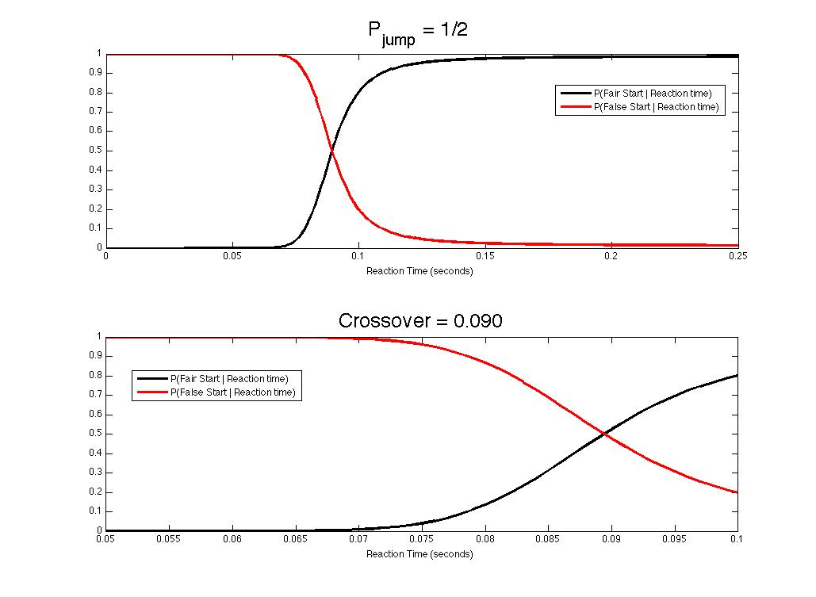
Bayesian approach

Slide 33
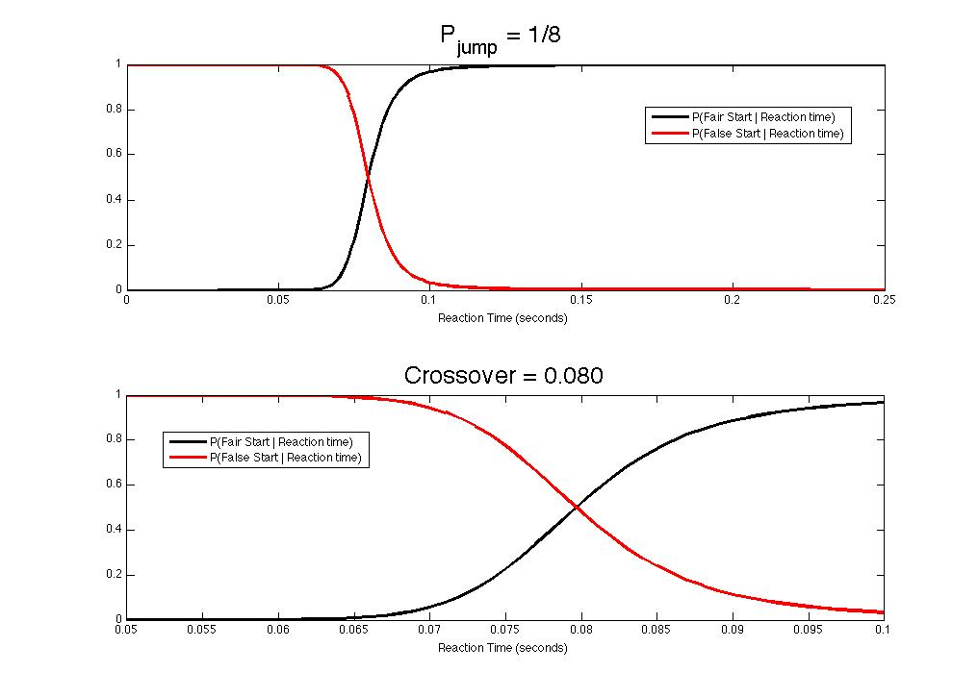
Bayesian approach

Slide 34
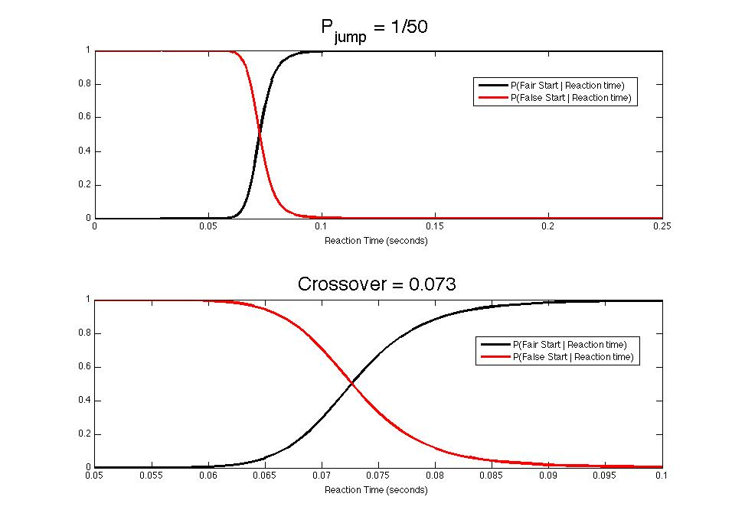
Bayesian approach

Slide 35
Current Matrix
 | OK | DQ
G | Clean start | Unfair DQ! (Type I error)
B | Unfair advantage / jump (Type II error) | Proper DQ

Slide 36
Desired Criteria
Strong disincentive to try to anticipate
Fairness (no penalty for another’s actions)
No false DQs

Slide 37
Recommendations
If current framework is kept, lower threshold to ~73 ms
Equipment dependent
No double DQ (for each start)
Automated firing suggested by Rosenthal
Key recommendation: two tiers of false starts

Slide 38
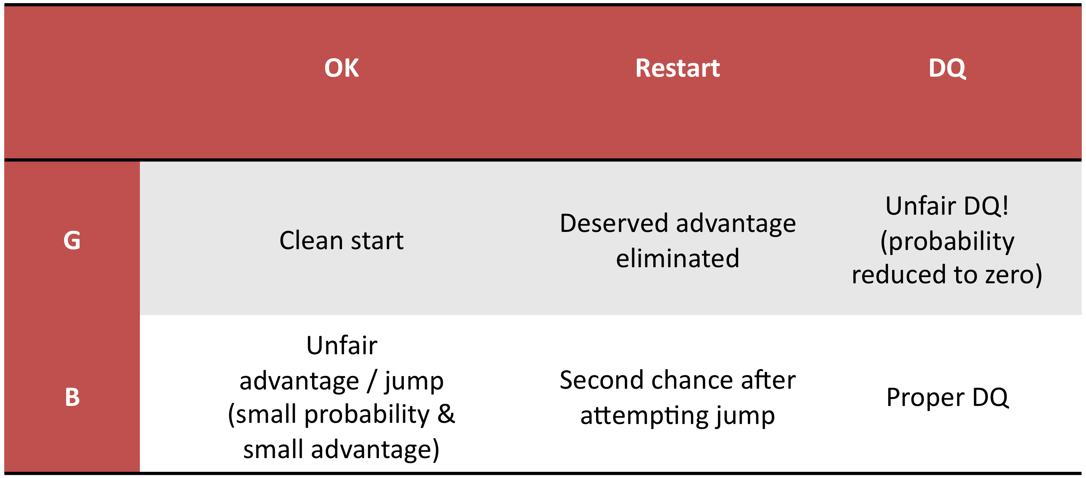
Matrix w/ Key Recommendation

Slide 39
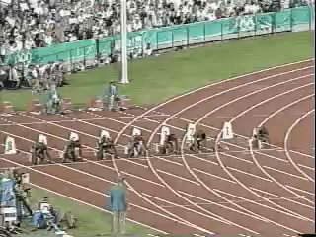
At last…..

